Slide 1

Minimizing Downtime | Reducing Costs | Maximizing Machine Lifespan
Predictive Maintenance
Transforming Operational Efficiency with Data-Driven Insights

Slide 2

The Problem
Unexpected machine failures leading to costly downtimes.
Impact on Business
01
High maintenance expenses due to reactive approaches.
02
Revenue losses
Decreased asset lifespan
Operational inefficiencies
Reduced operational efficiency and productivity.
03
Lack of real-time insights for preventive action.
04

Slide 3

The Solution: Predictive Maintenance (PM)
Proactive Monitoring: Uses sensors, data analytics, and machine learning to monitor equipment in real-time and predict failures before they happen.
Optimized Maintenance: Ensures maintenance is performed only when needed, avoiding unnecessary repairs and reducing costs.
Minimized Downtime: Prevents unexpected breakdowns, improving operational efficiency and productivity.
What is
Predictive Maintenance?
Predictive
Key
Benefits
Reduction in unexpected breakdowns.
Improved machine health monitoring and improved safety.
Data-driven decision-making for proactive strategies.

Slide 4


Dataset Overview
Source and Collection
Acquired operational data from machines.
Key Variables
Machine attributes (UDI, Product ID, Machine Type).
Operational metrics (Temperature, Speed, Torque, Tool Wear).
Failure classifications (Failure Modes).
Purpose of the Dataset
Training machine learning models to predict failures accurately.

Slide 5








Project Approach & Structure
Step-by-Step Workflow
Exploratory Data Analysis (EDA)
Model Selection
Deployment
Choosing Logistic Regression for Classification.
Integrating the model into real-world applications.
Understanding data trends and patterns.
Data Collection
& Cleaning
Feature Engineering
Model
Evaluation
Handling missing values and preparing data.
Transforming raw data into meaningful variables.
Assessing performance with accuracy, precision, recall, F1-score.

Slide 6


The Data Analysis Process
Key Insights Discovered
Techniques Applied
Dataset Overview: The dataset has 10,000 rows and 12 columns, with irrelevant unique identifiers removed.
Data Quality: No missing or duplicate values were found, ensuring high data integrity.
Outliers and Variability: Outliers in continuous variables were flagged for their potential impact on machine failures.
Data Cleaning: Removed missing values, duplicates, and unnecessary columns for better processing.
Variable Categorization: Segregated continuous and categorical variables for targeted analysis.
Outlier Detection: Identified outliers using statistical methods and boxplots for critical variables.

Slide 7
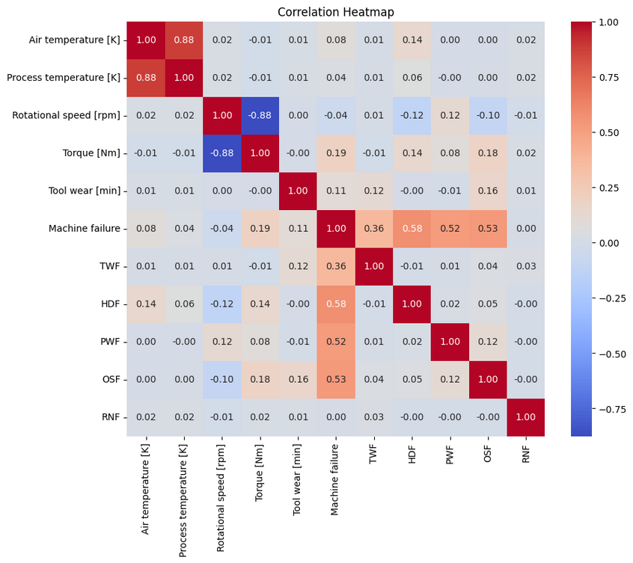
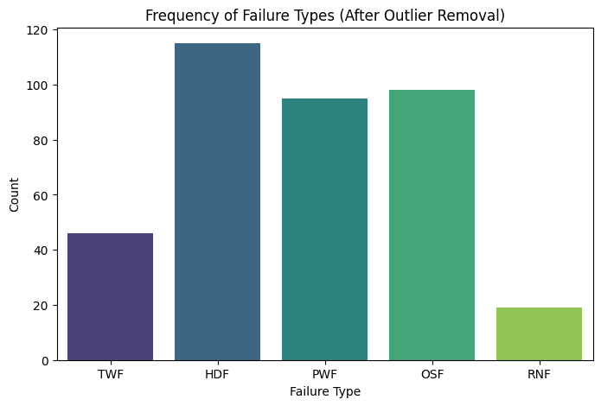
visualization

Slide 8

Feature Engineering & Model Selection
Performance Metrics:
Accuracy, Precision, Recall, F1-Score, ROC-AUC.
Feature Engineering Techniques
Model Selection Process
Scaling: Standardized continuous variables with StandardScaler.
Encoding: Converted categorical data using LabelEncoder.
Selection: Retained relevant features and removed redundant ones.
Chose Logistic Regression for:
Simplicity and interpretability.
Efficiency in handling binary classification.

Slide 9
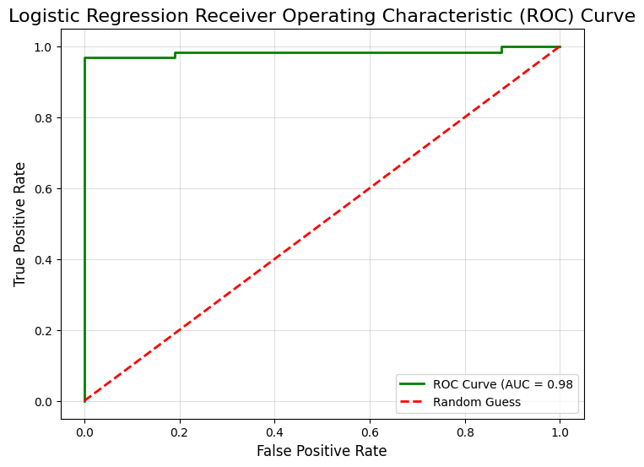
Logistic regression (ROC)curve

Slide 10


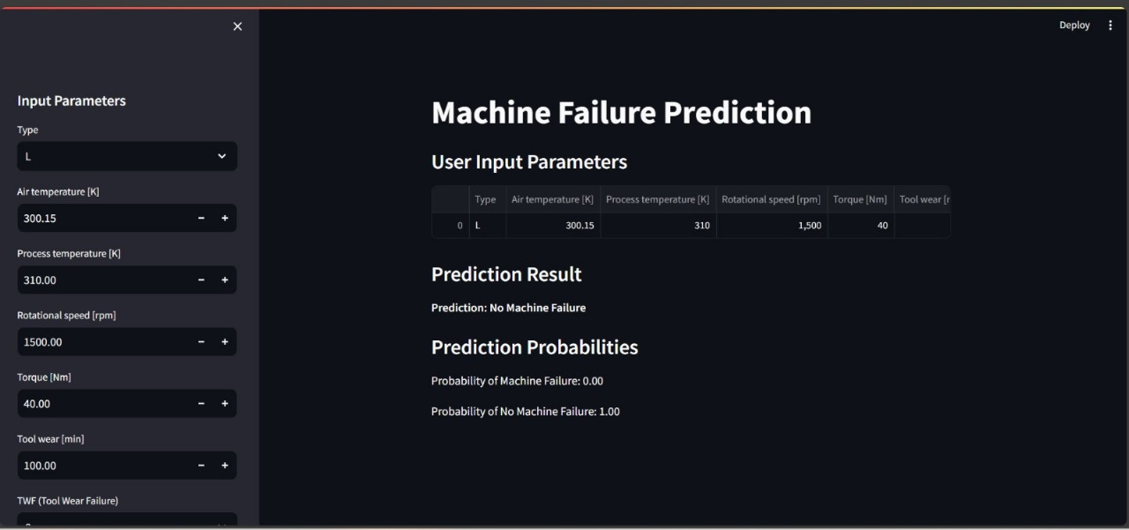

Deployment Process
The trained model is integrated with Streamlit for easy user interaction.
API development for real-time predictions.
User-friendly dashboard for insights.
Model Deployment Strategy
Deployment Architecture
Cloud-based or on-premise integration.
Input-output prediction workflows.

Slide 11


Machine Learning
Data Handling and Analysis
scikit-learn
pandas
numpy
Libraries used
Deployment
streamlit
Visualization
matplotlib
seaborn
Other Utilities
joblib or pickle

Slide 12
Challenges Encountered & Solutions
Challenge | Solution Implemented
Data Imbalance | Used SMOTE oversampling techniques
Feature Selection | Conducted correlation and feature importance analysis
Model Deployment Latency | Optimized model inference for real-time predictions
Explainability to Operators | Ensured model transparency with interpretable results

Slide 13




Advantages
Reduced downtime and maintenance costs.
Extended machine lifespan through proactive measures.
Data-driven decision-making for improved efficiency.
Disadvantages
High initial implementation cost.
Dependence on sensor data accuracy and availability.

Slide 14


Conclusion & Future Scope
Key Takeaways
Predictive Maintenance significantly enhances operational efficiency.
Logistic Regression proved to be an effective solution.
Deployment allows real-time insights for proactive measures.
Prevention is better than cure, and in industry, prediction is better than reaction.
Future Scope
Exploring advanced models like Neural Networks.
Expanding implementation to multiple industries.
Enhancing real-time monitoring systems.

Slide 15




Our Team Member
Nanda S.C
OMKAR SURESH DHAVALE
BEGARI ANKITH RAJ
Shaik Abdul Rahaman Fardin
Anthony Mary Cyril
SAI KIRAN K
Muppidi Dinesh Kumar

Slide 16


Thank You

